Slide 1
AI Resume & Interview Assistant
Personalized Resume Analysis and Interview Preparation Using Generative AI
Team Members:
Chalini
Spandana Basava Kulal

Slide 2
Understanding the Real-World Problem
Job seekers often use the same resume for multiple roles despite different job requirements.
Manually identifying missing skills and qualifications from each job description is time-consuming.
Existing interview preparation is often generic and not tailored to the candidate or specific role.
Candidates need a personalized system that connects resume analysis, skill-gap identification, and interview preparation.

Slide 3
Existing Solutions & Their Limitations
Existing Solution | What it does | Limitation
ATS / Resume Screening | Matches/ranks resumes | Mainly recruiter-oriented
Resume Matching Systems | Compares resume with JD | Often provides similarity/ranking
Resume Builders | Creates/improves resumes | Mostly generic recommendations
AI Resume Reviewers | Identifies resume issues | Limited interview integration
Interview Platforms | Provides mock interviews | Often separate from resume analysis
LLM Interview Systems | Generates personalized questions | Primarily focused on interview stage

Slide 4
Literature Survey
Author Name, Journal/Conference, Year | Research / Methodology | Dataset Used | Performance Metrics | Advantages | Disadvantages
Changmao Li et al., EMNLP, 2020 | Developed context-aware Transformer models for two tasks: T1: classify a resume into a Clinical Research Coordinator T2: predicts whether a resume is suitable for a given job description. The best model uses resume section encoding + multi-head attention decoding. | 6,492 resumes from 24,933 job applications, covering 252 positions in Clinical Research Coordinator roles. | 73.3% competence-level prediction accuracy; 79.2% job suitability prediction accuracy. | Captures contextual relationships better than simple keyword matching; directly considers resume and JD information; suitable for automated candidate screening. | Focused on specific job roles; primarily predicts suitability rather than explaining skill gaps or providing personalized recommendations.
Mingzhe Li et al., WSDM, 2023 EZInterviewer | Proposed a low-resource Mock Interview Generator. Uses a knowledge selector to select relevant resume a dialog generator pretrained on ungrounded conversations, decoding manager to combine them. Knowledge selector is pretrained using job–resume matching; dialog generator uses large-scale Weibo conversations. | Candidate resume/CV and job-description information used to construct personalized interview scenarios. | Automatic: BLEU-1 0.6106, BLEU-2 0.4320, BLEU-3 0.3284, BLEU-4 0.2917; Entity F1 0.3927; Correlation 0.3145; Dist-1 0.1071; Dist-2 0.3747. Human evaluation (1–3 scale): Readability 2.42, Usefulness 2.46, Relevance 2.57, Coherence 2.38. | Personalized interview generation; connects candidate profile with target role; enables interactive interview practice. | Mainly focuses on interview comprehensively address resume improvement, skill-gap analysis, and end-to-end career preparation.

Slide 5
Author Name, Journal/Conference, Year | Research / Methodology | Dataset Used | Performance Metrics | Advantages | Disadvantages
A. Malinowski et al., Procedia Computer Science, 2020 | 1) Resume classification using TF-IDF features with Random Forest, Multinomial Naive Bayes, Logistic Regression and Linear SVM; 2) Resume recommendation/ranking using content-based recommendation, cosine similarity. | Resume and job-description data used for automated resume recommendation and ranking. | Random Forest: 38.99%; Multinomial NB: 44.39%; Logistic Regression: 62.40%; Linear SVM: 78.53% using 10-fold cross-validation. 78.53% was the final/best classification accuracy. | Simple and computationally efficient; reduces manual resume screening effort; provides automated candidate ranking. | Relies heavily on similarity measures; limited semantic/contextual understanding; no conversational interaction or interview preparation..
Swanand Vaishampayan et al., Findings of NAACL, 2025 | Compared zero-shot GPT-4 ratings with human ratings for resume matching. Also evaluated task-based prompting, Chain-of-Thought (CoT), and CoT with examples. Used Pearson correlation and Fleiss' Kappa to measure agreement | 736 real-world resumes across four job categories: Project Manager, Accountant, Sales, and Engineer. | Zero-shot GPT-4 vs human: Pearson correlation Work Experience 0.5675, Skills 0.3823, Education 0.4091, Certification 0.3438. Fleiss' Kappa 0.228, 0.019, 0.153, 0.035, respectively. With task-based CoT + examples, correlation reached 0.3625, 0.3208, 0.6109, 0.6588 for the four categories. | Demonstrates the potential of LLMs for resume evaluation; investigates prompting and fairness; moves beyond traditional keyword matching. | LLM ratings were not fully interchangeable with human judgments; requires careful prompt design and validation; potential bias concerns.

Slide 6
Author Name, Journal/Conference, Year | Research / Methodology | Dataset Used | Performance Metrics | Advantages | Disadvantages
Zhiyuan Wen et al., PolyInterview, 2026 | LLM-based personalized interview platform. Uses CV + target JD for question generation, multi-turn answer-aware follow-ups, and four evaluators for text, speech and visual/non-verbal behavior. Uses KSA + STAR frameworks. Produces 13 behavior-level features → 10 assessment aspects → 2 competency tracks. | 101 accounts, 1,564 interview sessions, 7,665 questions from platform usage; expert evaluation was also conducted. | Matched-JD alignment in 93.7% of sessions; matched JD ranked first in 82.4% of sessions; 90.9% of sessions covered all five interview stages. Expert evaluation by 10 experts: question-plan quality 4.62/5, role relevance 4.80/5, stage coverage 4.83/5, follow-up relevance 4.65/5, actionable feedback 4.70/5. | Provides role-specific questions; supports multi-turn adaptive interviews; generates personalized feedback; closely connects CV and JD. | Primarily focuses on interview simulation and assessment; more complex than required for a small microproject; multimodal features increase implementation complexity.

Slide 7
Research Gap
Existing systems mainly focus on resume classification, candidate–job matching, or interview preparation separately.
Traditional approaches rely heavily on keyword matching and similarity scores, with limited contextual understanding.
LLM-based resume evaluation can provide better context, but human–LLM agreement is still imperfect, requiring careful prompting and validation.
Existing interview systems can generate personalized questions, but they generally do not connect interview preparation with resume–JD skill-gap analysis.
There is a need for a unified, candidate-centric system that connects resume analysis, skill-gap identification, resume improvement, and personalized interview preparation.

Slide 8
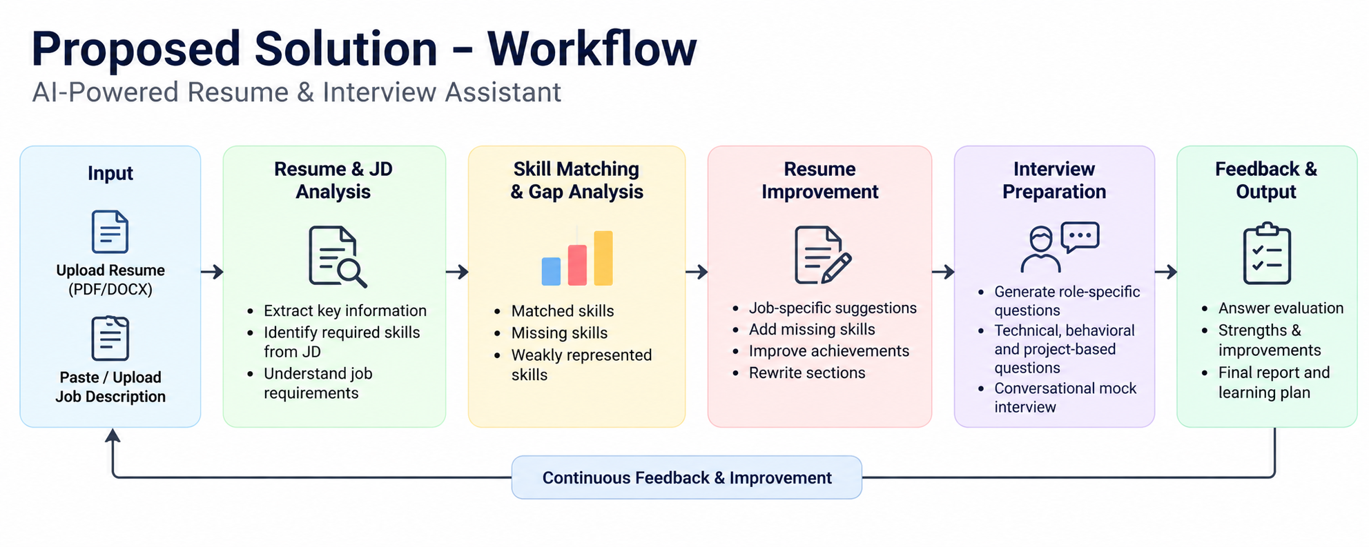

Slide 9
Innovation
Candidate-centric rather than recruiter-centric.
Combines resume analysis + skill-gap detection + interview preparation in one workflow.
Uses semantic understanding instead of only keyword matching.
Enables adaptive conversational interviews with follow-up questions.
Provides actionable feedback, not just a resume score.
Expected Outcome
The proposed system is expected to:
Reduce manual effort in comparing resumes with JDs.
Help candidates identify missing and weak skills.
Generate role-specific resume improvement suggestions.
Provide personalized mock interview practice.
Give structured feedback to improve interview performance.

Slide 10
THANK YOU

